Slide 1
STREAMIFY- ONLINE STREAMING APPLICATION
By- Bhavyom Singh Kushwaha
Jahanvi Paliwal​

Slide 2
TABLE OF CONTENT
Introduction​
Problem Statement
​Aim of the project
Approach
Tools and Technologies Used
​Architecture
Dataset Information
Steps to start Application
Flow of our application

Slide 3
Introduction
In today's digital age, online streaming has become an integral part of our lives, with millions of people around the world turning to streaming websites to watch their favorite content in real-time. Online streaming websites have revolutionized the way we consume content, offering users access to a vast array of content from news and sports to entertainment and education. In this project, we will explore big data technologies to power an online streaming website to help improve the user experience, increase user engagement and satisfaction, and drive business growth.

Slide 4
PROBLEM STATEMENT
The problem statement for our presentation on an online streaming website is to address the challenges and limitations that online streaming websites face when collecting and processing large volumes of user data, and how big data technologies can help overcome these challenges. We will also discuss the challenges of personalizing content for each user, making recommendations based on their viewing history and preferences, and providing a more engaging and personalized user experience.

Slide 5
AIM OF THE PROJECT
The aim of the project on the topic of "Online Streaming Website Using Big Data Technologies" will be to design and develop a robust and scalable online streaming platform that leverages big data technologies to provide a personalized and engaging user experience. The project will involve exploring and implementing various big data technologies to address the challenges and limitations faced by online streaming websites in collecting and processing large volumes of user data. The ultimate goal of the project will be to demonstrate the importance of big data technologies in the context of online streaming and how they can be used to enhance the overall user experience and drive business success in today's digital age.

Slide 6
APPROACH TO DESIGN THE PROJECT
Kafka is an open-source distributed stream-processing framework that collects real-time data from the e-commerce website and stores it in Kafka-broker (Cluster).
This stream of data is directed to the processing engine (Spark) through Kafka-consumer.
The data streams undergo various processes such as Data injection, Data Processing, Data Storage.
The processed data is stored in Cassandra (for further enhancement in the application).

Slide 7
KAFKA INTERNAL FUNCTIONING
The topic Streamify is created in the Kafka-Cluster.
We are going to use the following Kafka API'S.
Kafka-start-server- This will start the server.
Kafka Topics- This will create topic so that we can push data from producer.
Kafka-Producer collects all the stream of data from the user and allows the application to write that into the topic in the cluster.
From the other side, Sparks reads the data generated by producer from the topic.

Slide 8
TOOLS AND TECHNOLOGIES USED
HADOOP
KAFKA
SPARK
CASSANDRA
PYTHON
used for capturing and storing streams of real-time data into categories called topics and later gives it to a processing engine for analysis.
a data processing engine used for collecting data-stream from Kafka
NoSQL database management system used to store raw data
programming language
open-source software utility used for storage and computation of data.
Visual Studio Code- Integrated development environment (IDE).

Slide 9
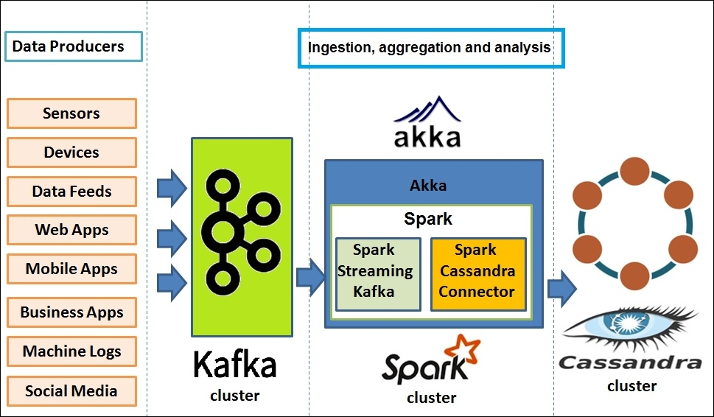
ARCHITECTURE

Slide 10
DATASET INFORMATION
Dataset used:
DATA ATTRIBUTES
Customers dataset
Name - customer’s name
Email - customer’s email address
Gender - customer’s gender
Age - customer’s age
Interest - customer’s interest

Slide 11
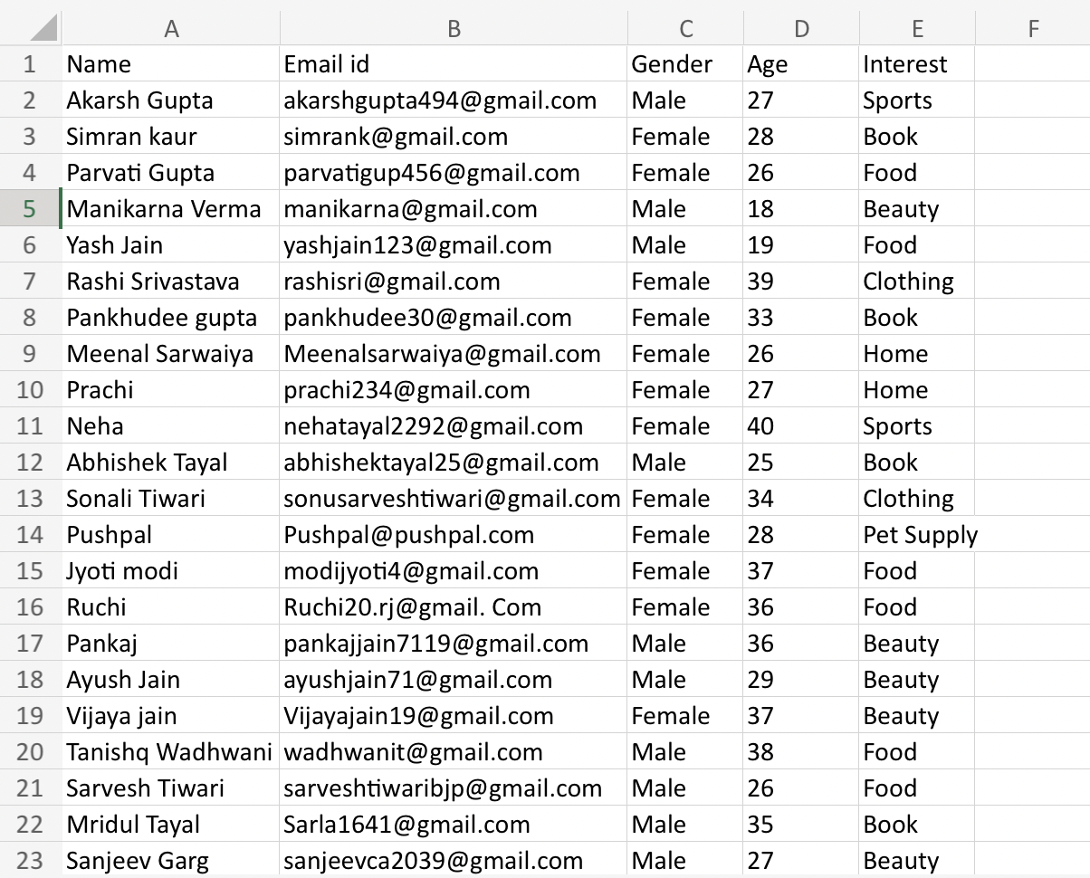
DATASET

Slide 12
STEPS TO START APPLICATION
Open 2 terminals in Ubuntu.
2. We must start zookeeper and kafka. I have create a single file where I have written commands for running both of these. On one terminal, write a command, “systemctl start kafka”. There will be a prompt asking for password, enter the password. The zookeeper and kafka server will start. To check if the server are running or not, use “systemctl status kafka”.
3. Write the command “kafka-topics.sh –bootstrap-server localhost:9092 –topic <topic name> --replication-factor 2”. Then press enter. This command as the same suggest, create a topic and bind it to localhost at port 9092.
4. Now, we need to start the producer. Write the command, “kafka-console-producer.sh –bootstrap-server localhost:9092 –topic <topic name>”. Then press enter. This command will start a console producer at localhost:9092 with some properties such as topic, replication factor and partition.
5. This terminal will act as a producer of information. It will write anything that you provide on the topic. Things written on the topic will be available for the consumer to consume.

Slide 13
1. On the other terminal, write the following command, “spark-submit –packages “com.datastax.spark:spark-cassandra-connector_2.12:3.3.0”,”org.apache.spark:spark-sql-kafka-0-10_2.12:3.3.2” <path of the file where you are reading messages from kafka topic>”. Then press enter. This will deploy the spark cluster.
2. In the above command, we are specifying a package for spark-cassandra connector library, that is used for establishing connection between spark and Cassandra. The other package is for kafka-spark connection.
3. Now, messages produced by producer will be available for consumer (spark application in out case). Once the consumer consumes the data, it will be processed by spark and stored in a specific format in Apache Cassandra.

Slide 14
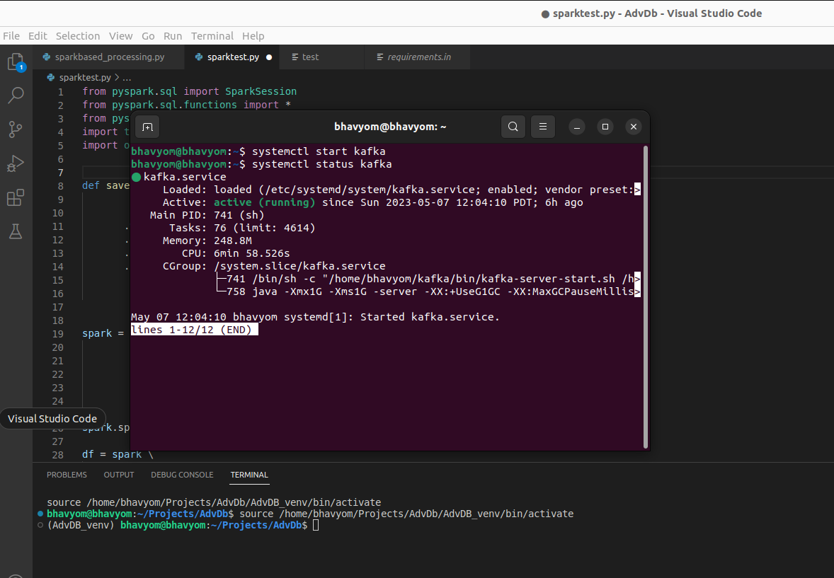
FLOW OF OUR APPLICATION

Slide 15
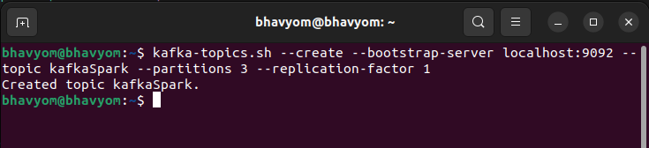
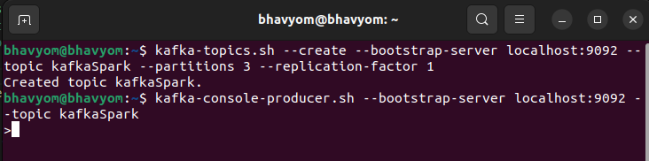

Slide 16
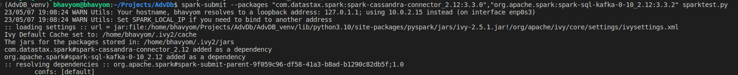
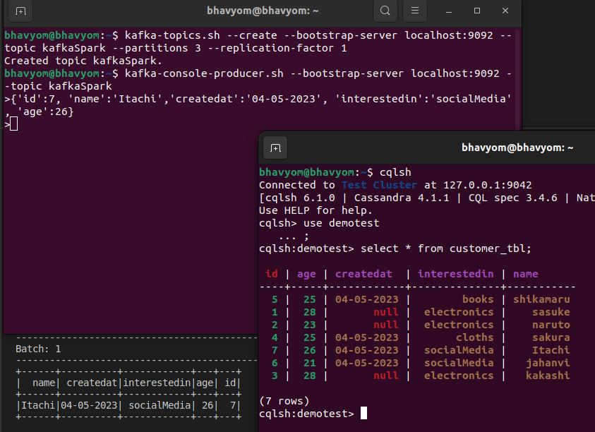

Slide 17
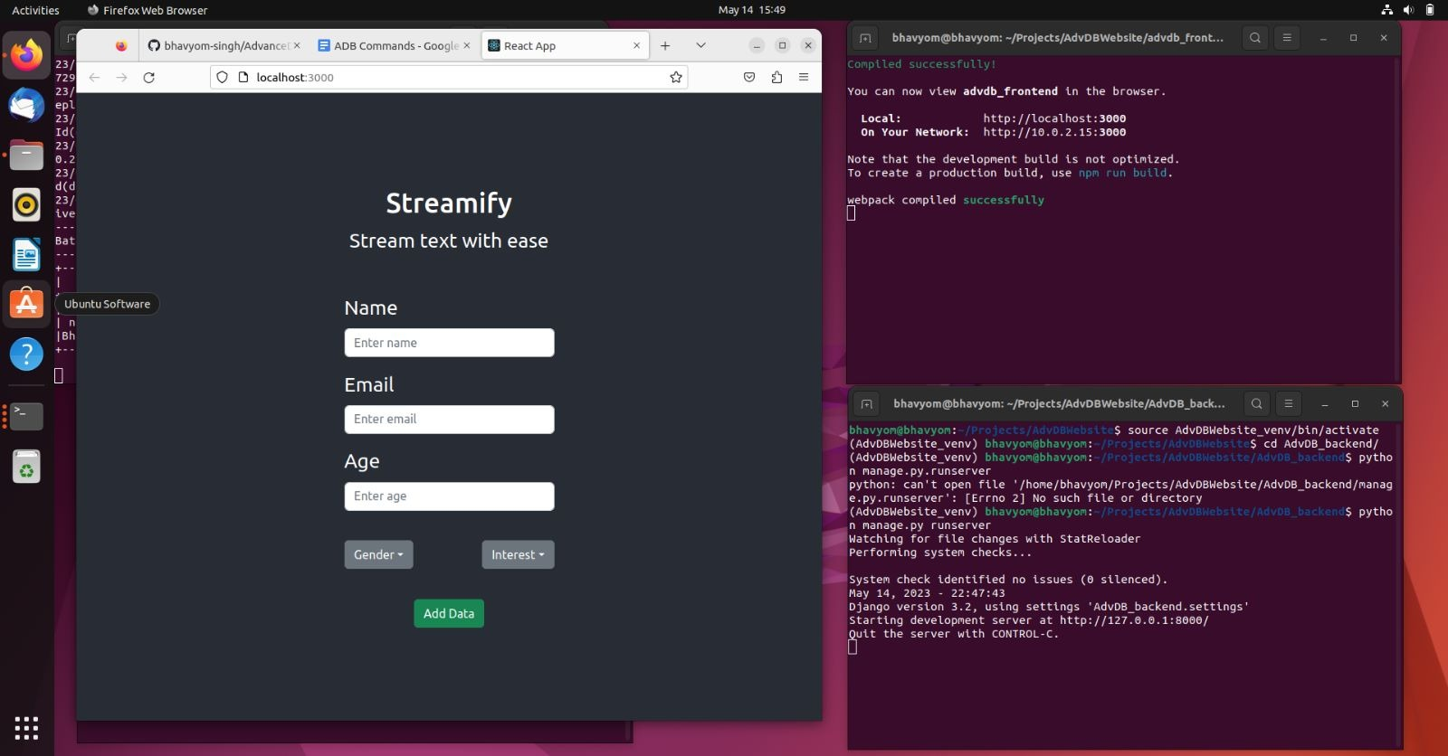

Slide 18
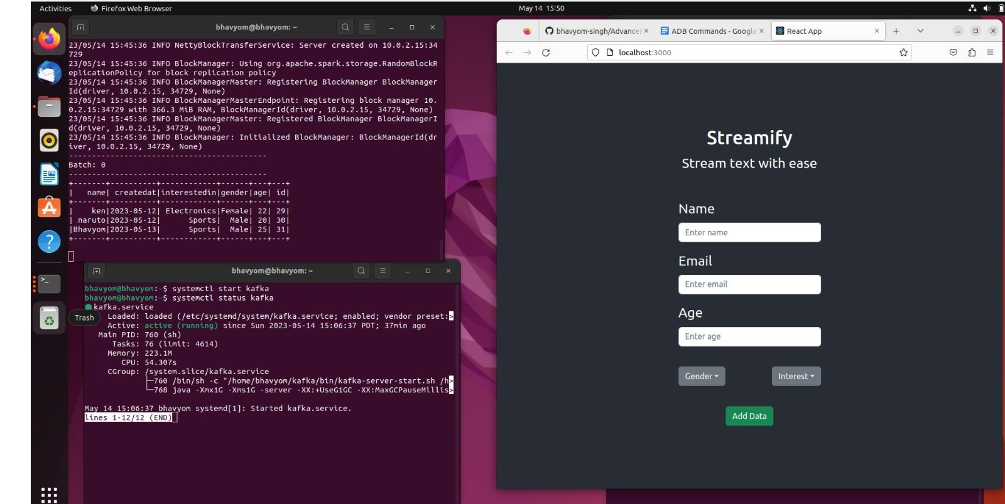

Slide 19
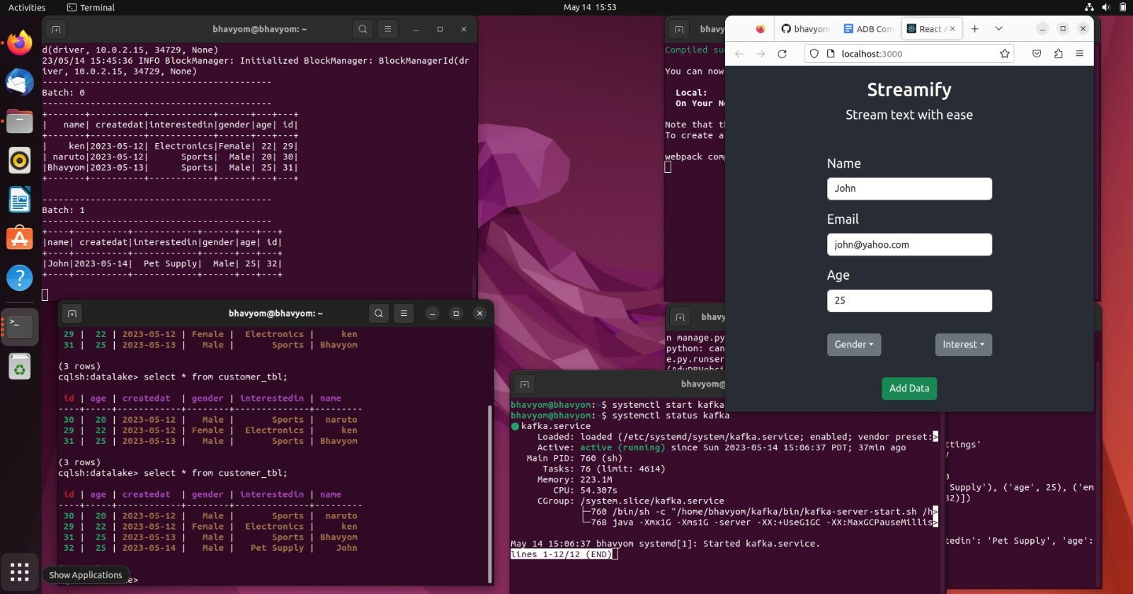

Slide 20
Github Link
https://github.com/bhavyom-singh/AdvanceDatabaseProject.git

Slide 21
THANK YOU

